Slide 1
Data Analysis of FIFA World Cup Key Metrics Influencing World Cup Success

Slide 2
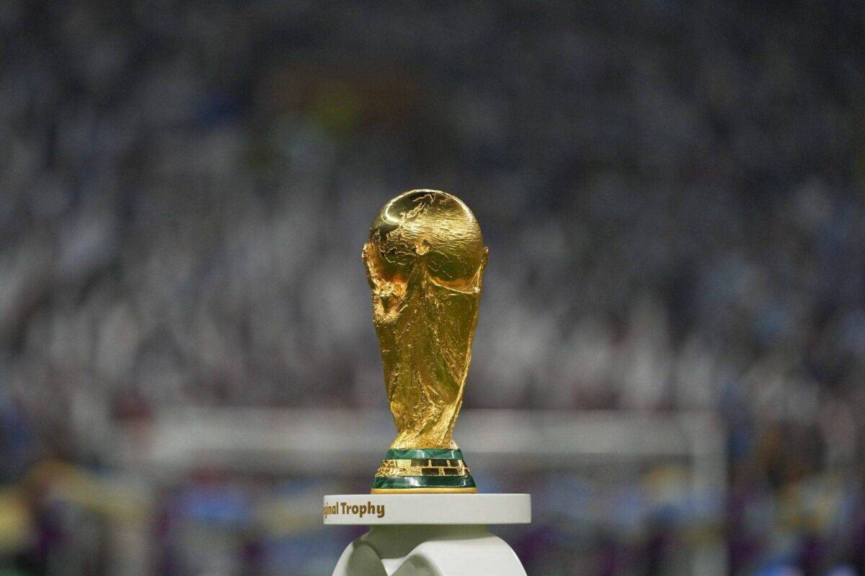
Introduction and Objective
Overview of FIFA World Cup
What is the FIFA World Cup?
The FIFA World Cup is the premier international football tournament, held every four years.
Teams from around the world compete for the title of world champion.
First tournament was held in 1930, hosted by Uruguay.
Importance and Global Significance
Cultural Impact: Unites fans globally, transcending borders, cultures, and languages.
Viewership: One of the most watched sporting events worldwide, with billions tuning in.
Economic Impact: Significant economic boost for host countries through tourism, infrastructure development, and global exposure.
Legacy: Winning the World Cup is the ultimate achievement in football, with legendary players and unforgettable moments etched in history.
Quotes:
"The World Cup is a very important way to measure the good players and the great ones. It is a test of a great player." – Pele

Slide 3
Main KPIs From the datasets, we can derive the following metrics: Goals Scored and Conceded Match Outcomes Player Contributions (Goals, Assists)

Slide 4
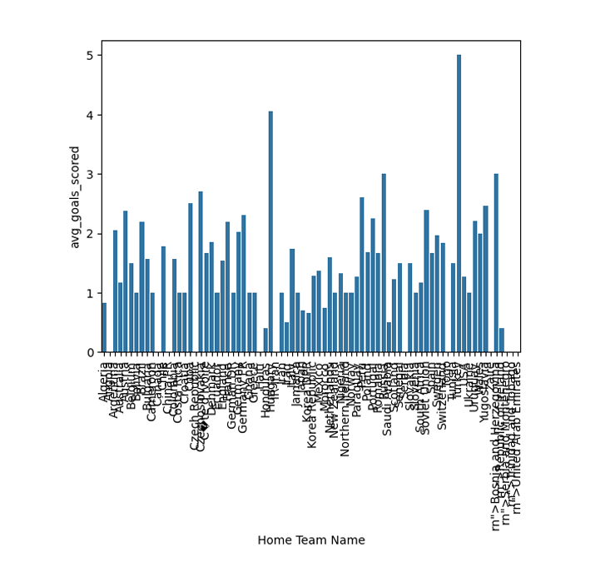
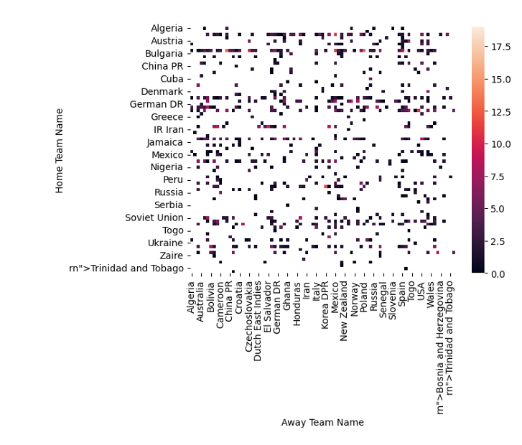
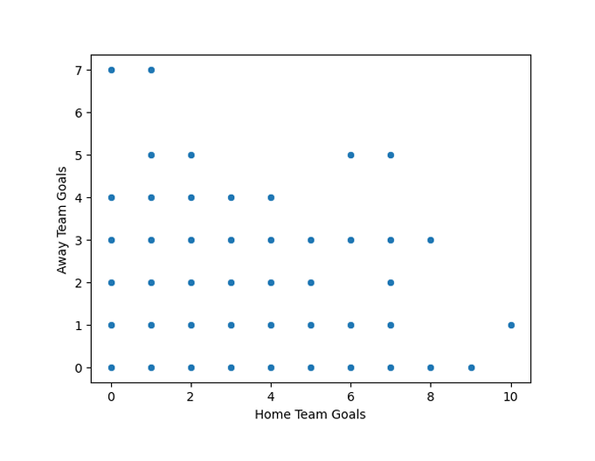
My Design

Slide 5
Thank you

